Slide 1

SHOW ALL WORK NEEDED TO ANSWER EACH QUESTION! Good Luck! ☺
1. Simplify completely:
2. Simplify completely:
A. B. C. D.
A. B. C. D.
3. Simplify completely:
4. Simplify completely:
A. B. C. D.
A. B. C. D.
5. Simplify completely:
6. Simplify completely:
A. B. C. D.
A. C. B. D.

Slide 2

7. Simplify completely:
8. Which expression is equivalent to ?
A. C. B. D.
A. C. B. D.
9. Which expression is equivalent to ?
10. Which expression is equivalent to ?
A. B. C. D.
A. C. B. D.
11. Which expression is equivalent to ?
12. Which expression is equivalent to ?
A. B. C. D.
A. B. C. D.
13. Simplify the expression below:
14. Simplify completely:
A. B. C. D.
A. C. B. D.

Slide 3

15. Which set of numbers does not contain the value below?
16. Which statement is false?
A. All real numbers are complex numbers. B. All irrational numbers are real numbers. C. All complex numbers are pure imaginary numbers. D. All whole numbers are rational numbers.
A. Complex Numbers B. Pure Imaginary Numbers C. Rational Numbers D. Integers
17. Which statement illustrates the associative property of addition?
18. Identify the multiplicative inverse of the value below.
A. B. C. D.
A. C. B. D.
19. Which is the complete factorization of the expression ?
20. Which of the following is the factored form of ?
A. B. C. D.
A. B. C. D.
21. For which polynomial is the expression a factor?
22. Which of the following expressions is not a factor of ?
A. B. C. D.
A. B. C. D.

Slide 4

23. Find the quotient:
A. B. C. D.
24. Solve:
25. What of the following represents the solution to the inequality below?
A. B. C. D.
A. B. C. D.
26. Which of the following describes the roots of the function ?
27. Solve:
A. exactly 1 rational root B. 2 distinct rational roots C. 2 distinct irrational roots D. 2 distinct imaginary roots
A. B. C. D.

Slide 5

28. Solve:
Which equation has a solution set of
?
A. B. C. D.
A. B. C. D.
30. Which is a solution to the equation ?
A. B. C. D.
31. Which is not a solution to the equation below?
32. A polynomial function has a zero at . Which of the following expressions must be a factor of the polynomial?
A. B. C. D.
A. B. C. D.

Slide 6

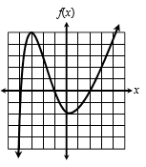
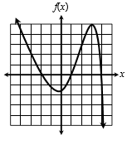
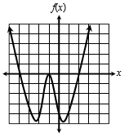
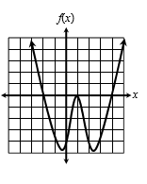
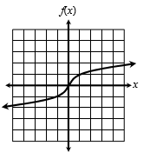
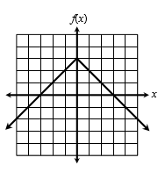
33. A polynomial function has a zeros at -4 (multiplicity 3), -1 (multiplicity 8) and 2 (multiplicity 1). Which equation could represent this function?
A.
B.
C.
D.
34. Solve:
35. Solve:
A. B. C. D.
A. B. C. D.
36. The graph of a parent function is shown below. Which function belongs to the same family?
37. The graph of the absolute value parent function is vertically stretched, then shifted 3 units left, 8 units down. Which equation could represent this function?
A. B. C. D.
A. C. B. D.
38. Which equation defines the function graphed below?
39. Which function has two distinct real zeros?
A. B. C. D.
A. B. C. D.

Slide 7

40. Which of the following describes the range of the function below?
41. Which function does not have a domain of all real numbers?
A. B. C. D.
A. B. C. D.
42. Identify the vertex of the function below.
43. Which of the following statements is true regarding the function below?
A. B. C. D.
A. (3, 0) is a zero and a relative minimum B. (3, 0) is a zero and a relative maximum C. (7, 0) is a zero and a relative minimum D. (7, 0) is a zero and a relative maximum
44. The graph of the cubic parent function is reflected across the x-axis. Which of the following describes the end behavior of the new function as x approaches negative infinity?
A. approaches negative infinity B. approaches positive infinity C. approaches 0 D. approaches 3
45. Which function family can have more than one increasing interval?
46. During which interval is the function below only decreasing?
A. Square Root B. Cube Root C. Quadratic D. Cubic
A. B. C. D.

Slide 8

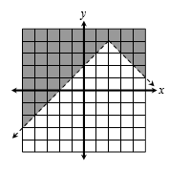
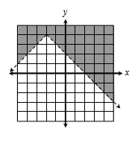
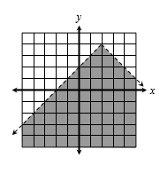
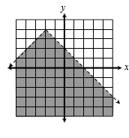
47. The graph of a quadratic function increases through the interval , then decreases through the interval . If the vertex of the graph is located at (5, 9), which equation could represent this function?
A. B. C. D.
48. Which graph represents the inequality ?
A.
B.
C.
D.
49. Kate’s soccer team is selling coupon books and recipe books to raise money for transportation to their games. Coupon books cost $12 each and recipe books cost $7.50 each. If Kate sold a total of 42 books and raised $441, how many coupon books did she sell?
A. 18 coupon books B. 24 coupon books C. 28 coupon books D. 14 coupon books
50. A baseball is thrown from a height of 5 feet. The height, h, of the ball at time t seconds is modeled by the equation h(t) = -16t² +100t + 5. How long will it take the ball to reach the ground?
A. 5.8 seconds B. 6.3 seconds C. 7.2 seconds D. 7.6 seconds

Slide 9

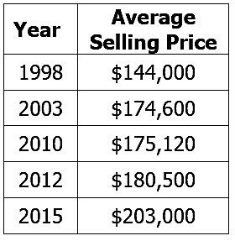
51. The table below shows the yearly average selling price of a home in the Orchard Woods subdivision during certain years. Using a quartic model, approximate the selling price of a home in Orchard Woods in 2020.
A. $300,303 B. $306,128 C. $310,502 D. $315,457
Use the functions , , and for questions 52-57.
52. Find
53. If , find x.
A. 8 B. -40 C. 20 D. -16
A. C. B. D.
54. Find
55. Find
A. B. C. D.
A. B. C. D.
56. Which describes the domain of the function
?
57. Find
A. All Real Number C. B. D.
A. 81 B. 420 C. 756 D. 915

Slide 10

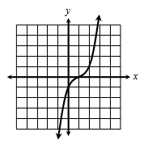
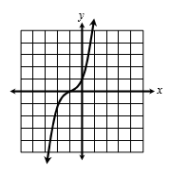
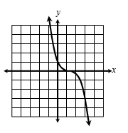
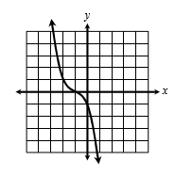
58. Find the inverse of the function below.
59. The point (-7, 1) lies on the graph of . Which point must lie on the graph of ?
A. C. B. D.
A. (7, -1) B. (1, -7) C. (-1, 7) D. (-7, -1)
60. Given , which graphs represents ?
A.
B.
C.
D.

